Slide 1
Housing in Orange County, FL
A project for UCF’s Data Analytics & Data Visualization Bootcamp.
Created by: Cindy Gorbas, Elizabeth Jaye, Dinielle Nelson, Robert Perron, and Dolly Vickers

Slide 2
Motivation & Summary
Team member, Cindy Gorbas, observed local real estate changes, particularly in East Orange County where she lives
Housing touches everyone and reflects economic and social changes in communities
We narrowed this focus to three factors of :
Availability
Affordability
Demographics

Slide 3
As housing volume increases,
is home ownership becoming a less attainable goal?

Slide 4
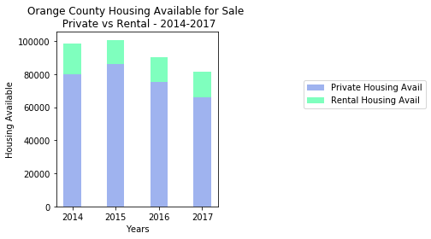
Question 1: Availability
Available Housing

Slide 5
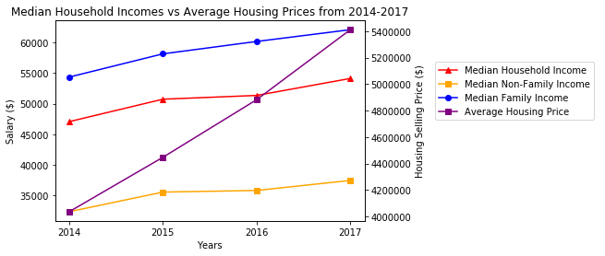
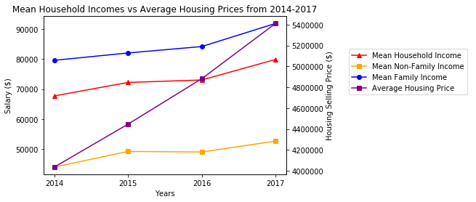
Question 2: Affordability
Income vs Housing Prices

Slide 6
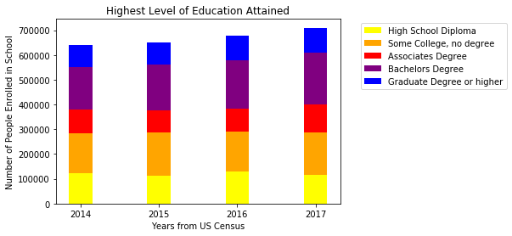
Question 3: Demographic Changes
Education

Slide 7
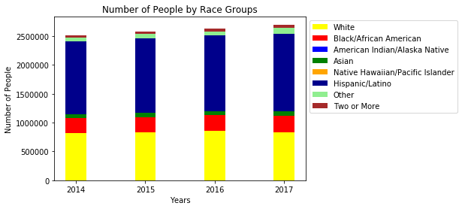
Question 3: Demographic Changes
Race

Slide 8
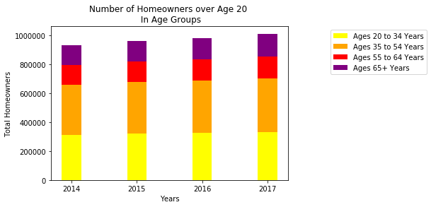
Question 3: Demographic Changes
Age Groups

Slide 9
Data Cleanup & Exploration
Methods of data collection including .csv pulls from the Multiple Listing Service (MLS) database and API pulls from the US government’s American Community Survey census.
Data clean up involved limiting year ranges based on overlap between two datasets, as well as targeting what was relevant and targeted in mass of data.
Surprising elements were the consistencies in demographics over time (though admittedly our year range is limited) and the discrepancy between family and non-family incomes.

Slide 10
Limitations and Follow up questions
Choosing a single US Census API, understanding documentation, and how it worked
The lack of overlapping years between the MLS and US Census
Meshing different types of data: Private vs Rental, Family vs Non-Family
Accessing data sets that were summaries vs individual data points
Questions of interest but out of scope:
Specific zip codes
Political events affecting the markets
New industries growing in the area
More complex demographic profiles
Effect of returning adult children to the home
Development patterns

Slide 11
Challenges
"Definitely being a novice to APIs and feeling limited in the range of information available.”
- Elizabeth
“…working with multiple people using the Github interface… my personal biggest issue on the entire project was figuring out how to keep my branch up to date with the correct version of the master... I struggled with uploading to Github more than I did in actually manipulating the data itself.”
- Robert
“Project management and how to approach the delegation of tasks.”
- Dinielle
“Gaps in foundational understanding on coding, coding errors and lack of experience with data wrangling…”
-Dolly

Slide 12
Questions & Answers

